Slide 1

Iterators and Generators in python
Dr. Rakhee chhibber

Slide 2
iterators
Iterators are something that help to loop over different objects in Python. Iterator goes over all the values in the list. Iterators apply the iterator protocol that contains basically two methods:
  _iter_()
  _next_()
Examples of iterables are tuples, dictionaries, lists, strings, etc. These iterables use iter() method to fetch the iterator.
atuple = ('avocado', 'beetroot', 'berries’)
myiter = iter(atuple)
print(next(myiter))
print(next(myiter))
print(next(myiter))

Slide 3
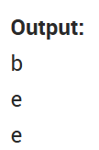
Strings as iterable objects
Strings are also considered iterable objects from which you can fetch an iterator.
astr = "beetroot"
theiter = iter(astr)
print(next(theiter))
print(next(theiter))
print(next(theiter))

Slide 4
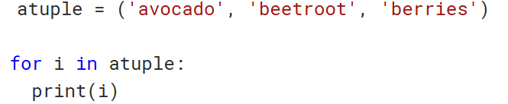
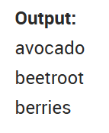
Loops as - an iterator
For loop can also be used to fetch through an iterable object.
Note - For loop - basically produces an iterator automatically and implements the next() method for every iteration.

Slide 5
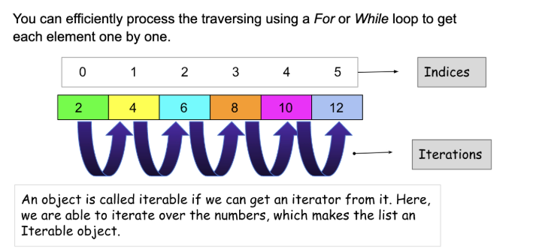

Slide 6
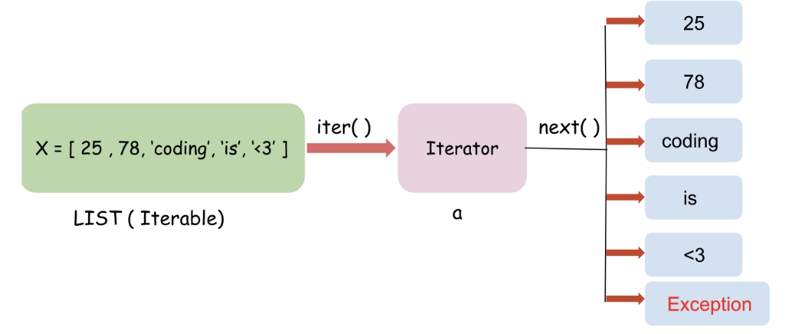
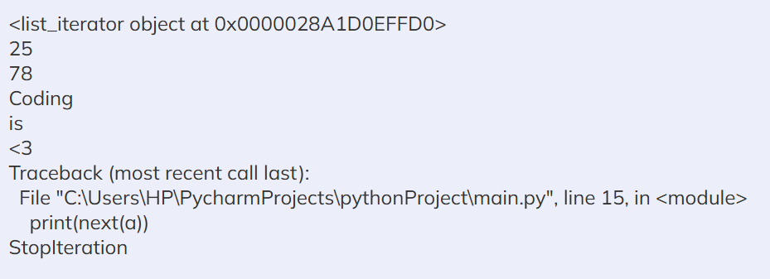

Slide 7
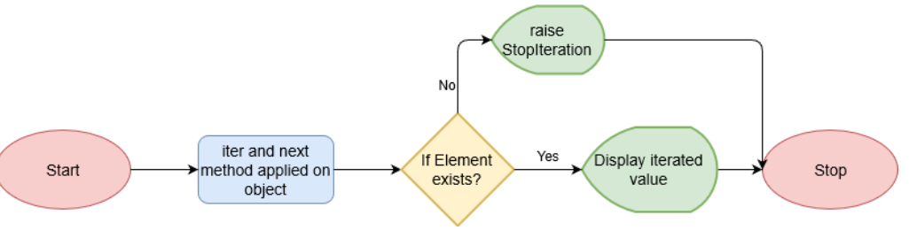

Slide 8
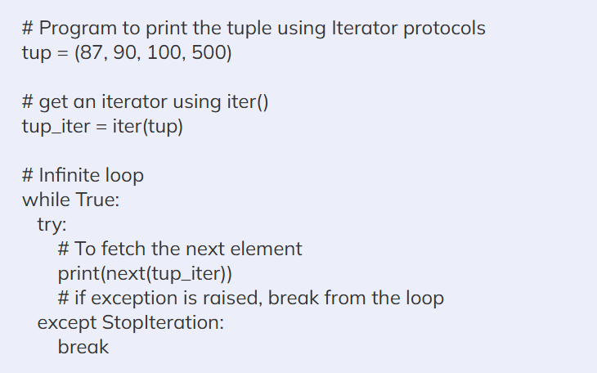

Slide 9
Loops vs Iterators
Loop (for / while): A control structure that repeats a block of code.
Iterator: An object that produces elements one at a time using __iter__() and __next__().

Slide 10
Why iterators
Memory Efficiency (Lazy Evaluation)
Work with Infinite Data
Consistency
Pipeline Processing

Slide 11
1. Memory Efficiency (Lazy Evaluation)
Eager Evaluation: The entire data structure is created and stored in memory before iteration starts.
Lazy Evaluation: Items are generated on demand only when needed, so memory is not wasted.

Slide 12
Eager vs lazy evaluation
numbers = (i for i in range(1_000_000)) # generator expression
print(type(numbers)) # <class 'generator'>
print(next(numbers)) # 0 (generated on demand)
print(next(numbers)) # 1
print(next(numbers)) # 2
✅ Numbers are created one by one only when needed.
✅ Saves memory, since the whole sequence is not stored.
❌ Slightly slower (because items are computed each time).
numbers = [i for i in range(1_000_000)]
print(type(numbers)) # <class 'list'>
print(len(numbers)) # 1000000
✅ The list is fully stored in memory (all 1 million numbers at once).
❌ Uses a lot of RAM.

Slide 13
Memory Comparison
import sys
lst = [i for i in range(1_000_000)] # list (eager)
gen = (i for i in range(1_000_000)) # generator (lazy)
print("List size:", sys.getsizeof(lst)) # ~8,000,056 bytes
print("Generator size:", sys.getsizeof(gen)) # ~112 bytes
👉 List: ~8 MB
👉 Generator: only ~112 bytes
That’s a huge difference 🚀

Slide 14
2. Work with Infinite Data
Loops need a known collection or condition.
Iterators can represent infinite sequences.
import itertools
count_iter = itertools.count(1) # infinite iterator
for n in count_iter:
if n > 5: break
print(n) # 1 2 3 4 5

Slide 15
3. Consistency
for loops internally use iterators.
Every iterable (list, tuple, dict, set) is converted to an iterator behind the scenes.
numbers = [1, 2, 3]
it = iter(numbers) # creates an iterator
print(next(it)) # 1
print(next(it)) # 2
print(next(it)) # 3

Slide 16
4. Pipeline Processing
Instead of processing all data at once and storing intermediate results, we chain multiple iterator operations together.
Each stage passes items to the next lazily, one by one.
This is like a factory pipeline: raw material → step1 → step2 → step3 → finished product.

Slide 17
Pipeline with eager vs lazy iterators
Let’s say we want to: Take numbers 0–9 Keep only even numbers Square them
Pipeline(Iazy Iterators) - use filter(), map(), or generator expressions.
Pipeline(Eagar)
data = list(range(10)) # step 1: full list in memory
evens = [x for x in data if x % 2 == 0] # step 2: new list
squares = [x**2 for x in evens] # step 3: another list
print(squares) # [0, 4, 16, 36, 64]
data = range(10) # range is already lazy
evens = filter(lambda x: x % 2 == 0, data) # lazy filter
squares = map(lambda x: x**2, evens) # lazy map
print(list(squares)) # [0, 4, 16, 36, 64]
For each number in range(10):
  filter checks if it’s even.
  If yes → passes it to map.
  map squares it and yields the result.
  Only then Python moves to the next number.

Slide 18
Why iterator?
If you deal with large datasets (millions of records), eager lists can crash memory.
Iterators (lazy) let you process streams of data efficiently, like:
  Reading files line by line
  Streaming logs
  Processing data from a database
  Infinite sequences (e.g., Fibonacci, counters)

Slide 19
generators in python
Dr. Rakhee chhibber

Slide 20
Introduction
Python has a generator that allows you to create your iterator function. A generator is somewhat of a function that returns an iterator object with a succession of values rather than a single item. A yield statement, rather than a return statement, is used in a generator function.
The difference is that, although a return statement terminates a function completely, a yield statement pauses the function while storing all of its states and then continues from there on subsequent calls.

Slide 21
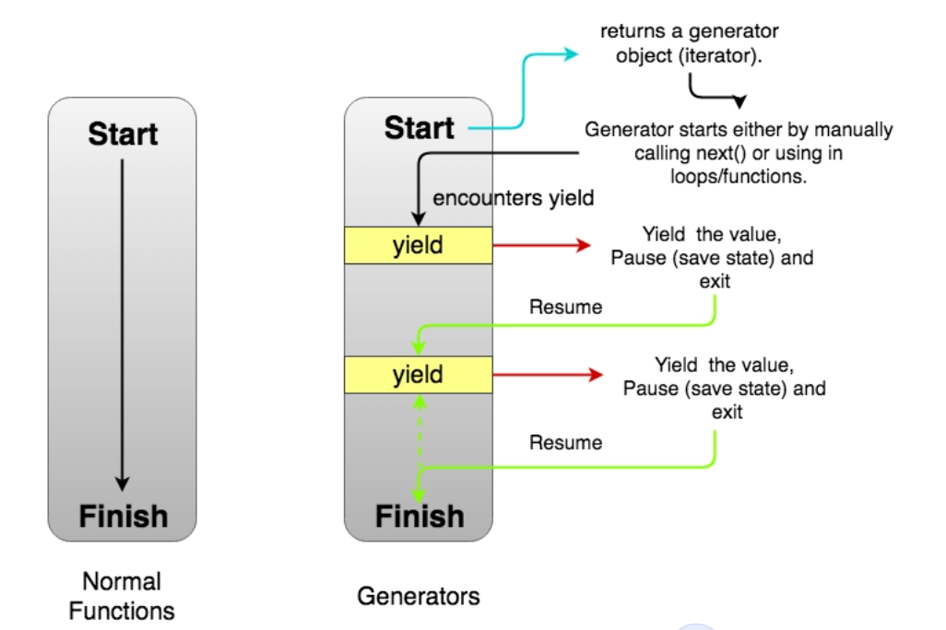

Slide 22
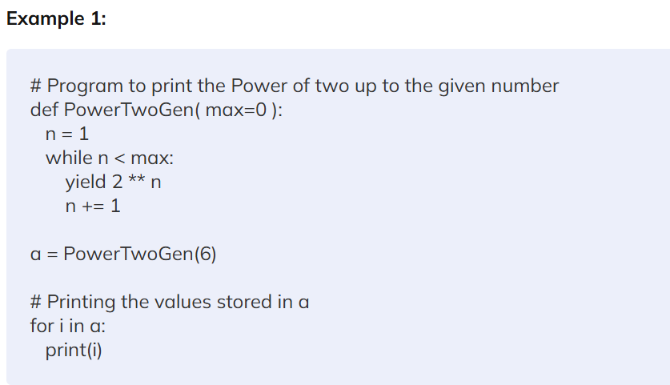

Slide 23
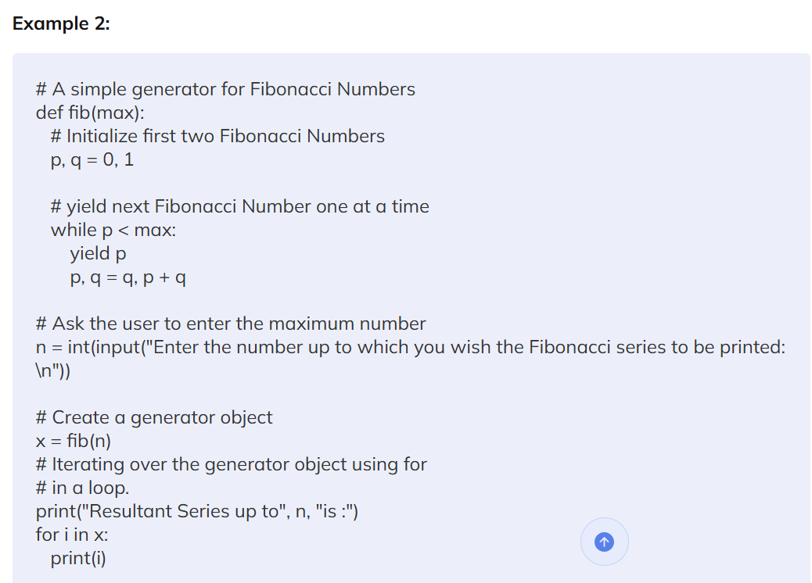

Slide 24
Why use generators when the return statement is already present?
The most well-known feature of generators is their excellent memory efficiency. A standard function that returns a sequence will first construct the whole sequence in memory before returning the result. If the number of elements in the sequence is enormous, this is overkill. The generator implementation of such sequences, on the other hand, is memory-friendly and preferable since it only generates one item at a time.

Slide 25
Difference Between Iterators and Generators in Python
Iterators | Generators
Iterators are the objects that use the next() method to get the next value of the sequence. | A generator is a function that produces or yields a sequence of values using a yield statement.
Classes are used to Implement the iterators. | Functions are used to implement the generator.
Every iterator is not a generator. | Every generator is an iterator.
Complex implementation of iterator protocols .i.e., iter() and next(). | Generators in Python are simpler to code than do the custom iterator using the yield statement.
Iterators in python are less memory efficient. | Generators in Python are more memory efficient.
No local variables are used in Iterators. | All the local variables are stored before the yield statement.

Slide 26
Modules in python
Dr. Rakhee chhibber

Slide 27
What is modules?
In Python, Modules are simply files with the “.py” extension containing Python code that can be imported inside another Python Modules Operations Program.
Module to be the same as a code library or a file that contains a set of functions that you want to include in your application.
can organize related functions, classes, or any code block in the same file.

Slide 28
Components of modules
Definitions and implementation of classes,
Variables, and
Functions that can be used inside another program.

Slide 29
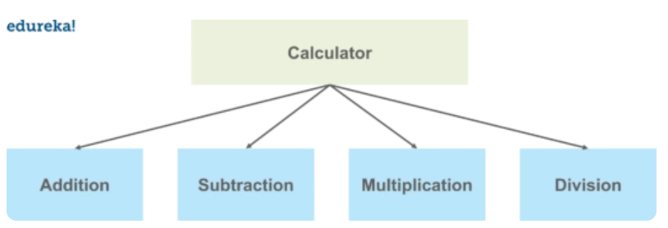
example
Suppose we want to make an application for a calculator. We want to include few operations in our application such as addition, subtraction, multiplication, division, etc.

Slide 30
Python Built-in Modules
Sr.No. | Name & Brief Description
1 | os - provides a number of operating system functions.
2 | string- contains a number of functions for string processing
3 | re- provides a set of powerful regular expression facilities. Regular expression (RegEx), allows powerful string search and matching for a pattern in a string
4 | math -implements a number of mathematical operations for floating point numbers.
6 | Datetime - provides functions to deal with dates and the time within a day.
7 | Sqlite3 - using SQLite 3.x.
8 | Statistics - Mathematical statistics functions

Slide 31
Python User-defined Modules
Any text file with .py extension and containing Python code is basically a module. It can contain definitions of one or more functions, variables, constants as well as classes. Any Python object from a module can be made available to interpreter session or another Python script by import statement. A module can also include runnable code.

Slide 32
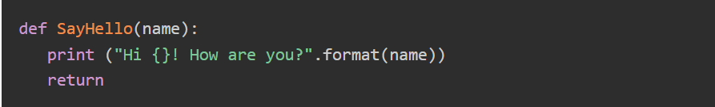
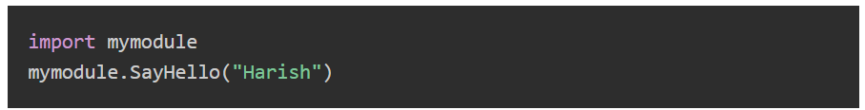
Creating a Python Module
mymodule.py
Example.py

Slide 33
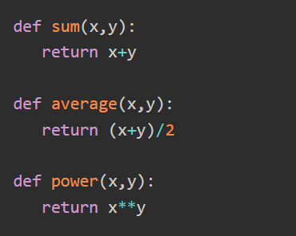
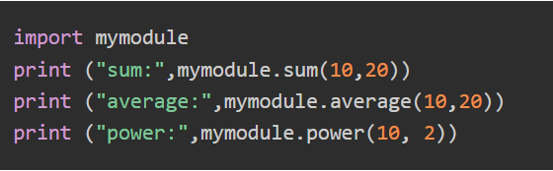
Mymodule.py

Slide 34
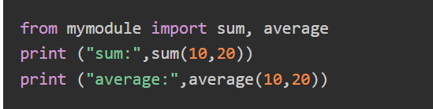
The from ... import Statement

Slide 35

The from...import * Statement

Slide 36
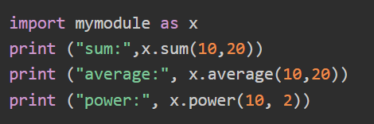
The import ... as Statement

Slide 37
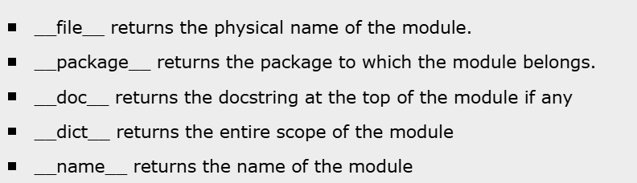
Module Attributes

Slide 38
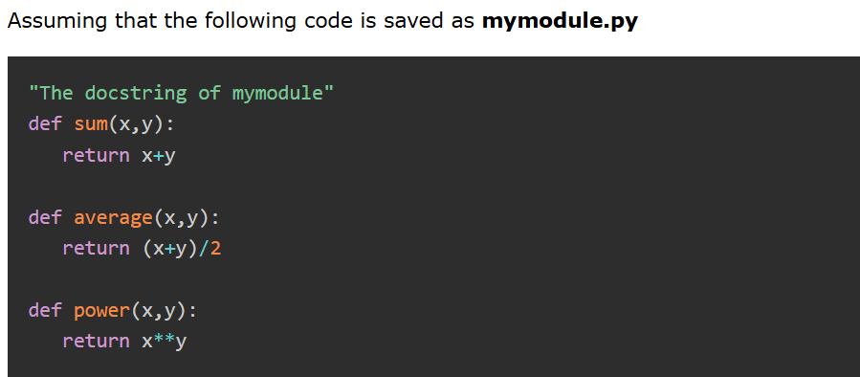
example

Slide 39
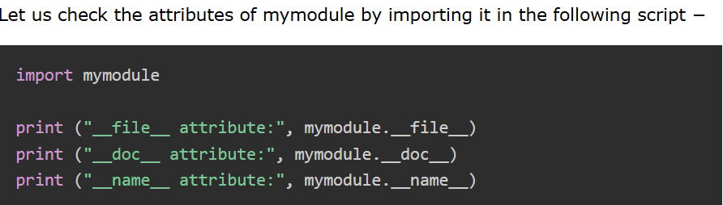

Slide 40
Files in python
Dr. Rakhee chhibber

Slide 41
Introduction
File handling in Python involves interacting with files on your computer to read data from them or write data to them
  1. Opening a File in Python
  2. Reading a File in Python
  3. Writing to a File in Python
  4. Closing a File in Python

Slide 42
Opening a file
file = open("filename", "mode")

Slide 43
Mode | Description
r | reading only and file pointer is placed at the bof. Default mode
rb | reading only in binary format. The file pointer is placed at the bof
r+ | both reading and writing. The file pointer placed at the bof
rb+ | both reading and writing in binary format. The file pointer placed at bof
w | writing only. Overwrites the file if the file exists. If the file does not exist, creates a new file for writing.
b | file in binary mode
wb | writing only in binary format. Overwrites the file if the file exists. If the file does not exist, creates a new file for writing.
w+ | file for both writing and reading. Overwrites the existing file if the file exists. If the file does not exist, creates a new file for reading and writing.
wb+ | both writing and reading in binary format. Overwrites the existing file if the file exists. If the file does not exist, creates a new file for reading and writing.
a | a file for appending. The file pointer is at the end of the file if the file exists.
ab | file for appending in binary format. The file pointer is at the eof.

Slide 44
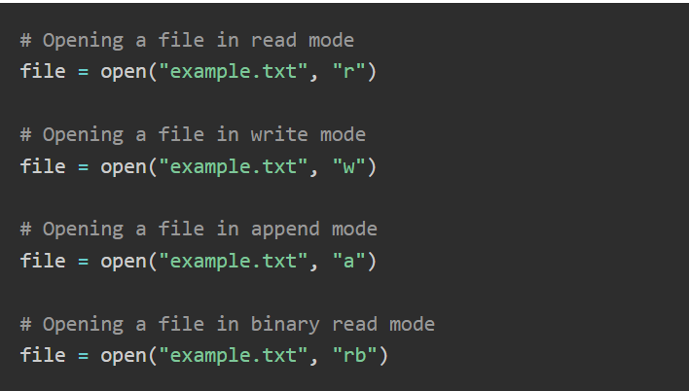
Example 1

Slide 45
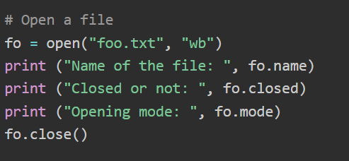
Example 2

Slide 46
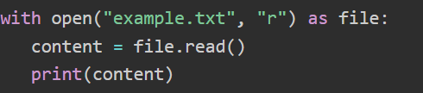
Reading a File in Python
read() − Reads the entire file.
readline() − Reads one line at a time.
readlines − Reads all lines into a list.

Slide 47
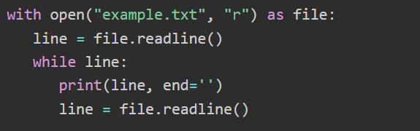
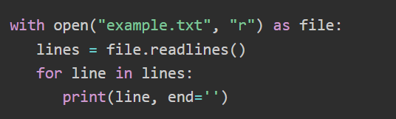

Slide 48
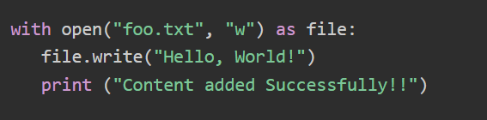
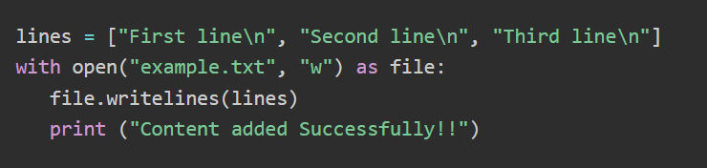
Writing to a File in Python

Slide 49
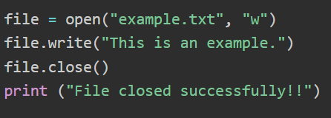
Closing a File in Python

Slide 50
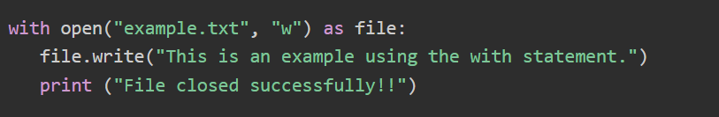
Using "with" Statement for Automatic File Closing

Slide 51

Thank You

